Slide 1
DSA
LECt#9

Slide 2
Graph Representation
Adjacency Matrix Representation
List Representation

Slide 3
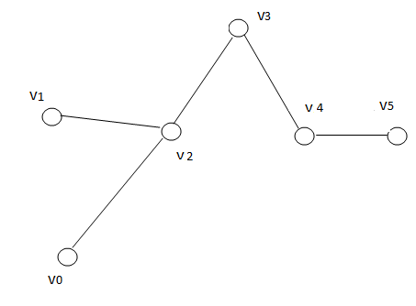
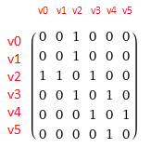
Adjacency matrix representation

Slide 4
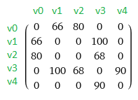
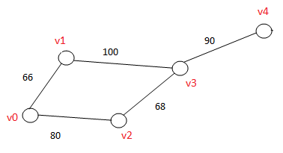
Adjacency matrix representation
Adjacency matrix for the weighted graph

Slide 5
Adjacency list representation
The adjacency list stores information about only those edges that exists.
The list contains a directory (dict) containing adjacency list for vertex.
Example:
{v0:[v1 v2]}
{v1:[v2]}
{v2:[v0 v1]}

Slide 6
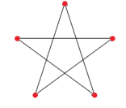
Class Assignment
Create an adjacency matrix for the given graph:

Slide 7
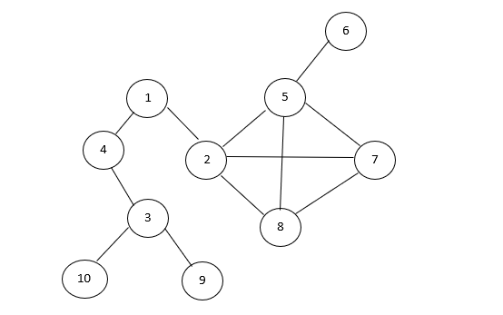
Class Assignment
Show the adjacency list for the given graph.

Slide 8
THANK YOU

